Slide 1

AstroSage Capital Allocation & Operational Optimization Strategy
Deploying a 1 Crore INR Investment to Maximize Operational Efficiency, Profitability, and Customer Satisfaction
MAITREYEE DEVI MAHANTA

Slide 2
Introduction & Project Objective
Context: AstroSage provides digital spiritual consultation services connecting users with astrological experts (Gurus) via calls and chats.
Core Objective: To evaluate operational metrics, consultation channels, traffic distributions, and rating feedback to maximize platform performance.
Strategic Goal: Identify service bottlenecks (e.g., missed connections) and top revenue-driving vectors to optimize consultant scheduling and improve user retention.

Slide 3
Problem Statement
Capacity Bottlenecks: High customer drop-offs and "Busy" statuses during peak hours indicate a supply-demand mismatch in consultant availability.
Revenue Optimization: Unbalanced monetization across consultation types requires clear data boundaries to isolate underperforming channels.
Quality Control: A high concentration of unrated or low-rated profiles among both users and consultants poses a risk to consistent platform quality.

Slide 4
Data Overview & Dataset Composition
Source Material: Structured transactional data extracted from "Astrosage-excel project.xlsx" containing comprehensive user/consultant logs.
01
Key Dimensions: Analyzed over 45 variables including consultation type, call/chat status, device channels, ratings, financial net amounts, and time metrics.
02
Scale of Active Reach: Features a tracked footprint of 28,028 total active users generating ₹2,13,987 in gross revenue.
03

Slide 5
Analysis Methodology
Data Extraction & Cleaning: Handled missing data points, isolated system anomalies, and verified chronological timestamps within the spreadsheet.
Aggregation & Logic: Implemented logical groupings to separate interactions by hour, day, consultation category, and specific consultant IDs.
Visualization Architecture: Synthesized raw data arrays into a dynamic, filterable executive view using uniform charts to support strategic business decisions.

Slide 6
Executive Performance Overview
Financial Health: Generated a Total Revenue of ₹2,13,987 with a robust Net Profit of ₹1,14,841.
User Base: Active engagement sustained across a user ecosystem of 28,028 total active users.
Quality Benchmark: Maintained a platform-wide Average Rating baseline of 2.93 / 5.00.

Slide 7
Platform & Traffic Distribution
Mobile Dominance: The "App" channel constitutes the overwhelming majority of user traffic with 20,225 entries.
Web Footprint: Desktop or web-based "Dashboard" traffic accounts for 7,800 of the interactions.
Direct Channel: "Guru Call" direct entry points represent a minor fraction of the distribution with only 2 entries.

Slide 8
Revenue Allocation by Consultation Type
Primary Driver: "Call" consultations serve as the core revenue engine, contributing ₹1,68,442.03.
Secondary Stream: "Chat" services represent the second largest monetization segment at ₹45,464.08.
Low/Non-Monetized: "Public Live Calls" account for a marginal ₹58.59, while "Complimentary" offerings generate ₹0 net amount.

Slide 9
Hourly Call Volume Dynamics
Peak Demand Windows: Platform traffic experiences a steady climb starting at 05:00, peaking heavily between 07:00 and 11:00 (with Hour 8 exceeding 600 sessions).
Sustained Engagement: A secondary steady operational block is sustained through the afternoon from 12:00 to 16:00.
Night Operations: Interaction levels drop significantly after 20:00, reaching their lowest operational floor between 00:00 and 04:00.

Slide 10
Macro Volume Trends (Daily Breakdown)
Volume Surge: Highest platform activity spikes are visible around early-to-mid December, with a noticeable max peak of 438 calls on 11-12-2023.
Mid-Month Stabilization: Traffic stabilizes into a predictable baseline oscillation of roughly 200–300 daily calls between Dec 15th and Dec 25th.
End-of-Cycle Taper: A gradual downward trend is observed moving into late December and early January, closing near 107–150 calls.

Slide 11
Platform Capacity & Session Success Rate
Fulfillment Efficiency: A majority volume of 3,450 consultation attempts successfully reached a Completed status.
Capacity Constraints: A total of 1,270 attempts resulted in a Busy status, highlighting moments of high demand or consultant unavailability.
Actionable Takeaway: Optimizing consultant schedules during the "Busy" bottlenecks could unlock trapped revenue.

Slide 12
Rating-Wise User Distribution
Polarized Baseline: A significant volume of users (7,398) recorded a baseline score of 0, indicating either unrated sessions or immediate friction.
Satisfied Clusters: Secondary peaks are healthy and concentrated around the 2-star (4,328) and 3-star (4,407) marks.
High-Tier Retention: Standard positive ratings drop off sequentially beyond the 3-star tier, trailing down past 4 and 5.

Slide 13
Rating-Wise Guru Distribution
Unrated/New Profiles: A massive share of consultants (7,250) sit at a 0-rating classification, indicating a high volume of inactive or newly boarded Gurus.
Core Active Fleet: The bulk of proven, reviewed consultants maintain a reliable rating average between 2 and 3 stars (~4,300+ gurus each).
Elite Stratum: High-performing tier gurus (ratings 5 through 8) maintain a stable, uniform distribution of roughly 1,800 to 2,100 experts per tier.

Slide 14
Top 10 Gurus by Consultation Volume
Volume Leader: The leading consultant dominates platform engagement with an individual consultation volume of 1,586.
Top Tier Cluster: The top 4 consultants consistently clear the 1,000+ session threshold, serving as critical operational pillars.
Consistent Output: The remaining consultants in the top 10 display highly competitive, stable volume output ranging between 735 and 777 total interactions.

Slide 15
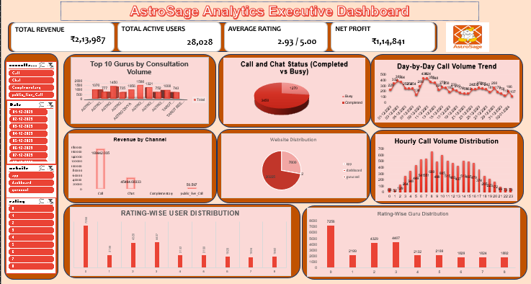
AstroSage Analytics Executive Dashboard

Slide 16
Strategic Vision & Targeted ROI Metrics
  Monetization Action Plan: Maximize the platform's financial yield by establishing a targeted 15% reduction in "Busy" status calls during peak hours (07:00–11:00) through data-driven consultant shift planning.
  User Engagement Roadmap: Leverage the dominant mobile application footprint to deploy proactive, automated post-session feedback loops, systematically reducing the volume of unrated (0-star) profile distributions.
📊 Data Reference Link: Detailed financial data breakdowns, raw transactional matrices, and dynamic KPI architectures are available for review in the source file https://d.docs.live.net/3bc3ca933409557d/Documents/newton%20p/Astrosage-excel%20project.xlsx

Slide 17
Strategic Recommendations & Conclusion
Targeted Scheduling: Shift consultant login hours to mirror the major morning spike (07:00–11:00) to decrease the 1,270 Busy instances.
Feature Optimization: Double down on mobile application enhancements, as the App channel hosts over 70% of user traffic.
Quality Intervention: Introduce post-session incentives to address the high volume of 0-rated interactions, moving them toward verified user feedback loops.

